Slide 1

Raytheon Cyber
April 2021
Photo by Reuben Wu.
Heather Romero
Embedded Cyber Technology Area Director
Raytheon Intelligence & Space (RIS)
Notes:
eTPCR RIS-18859

Slide 2

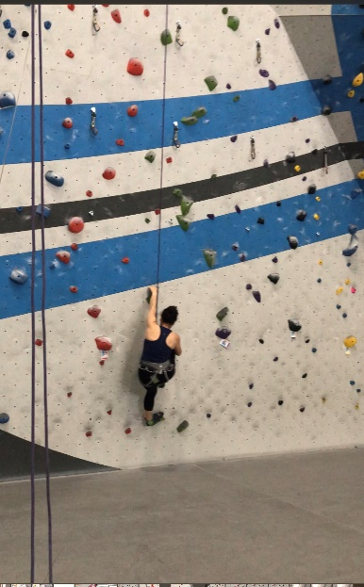


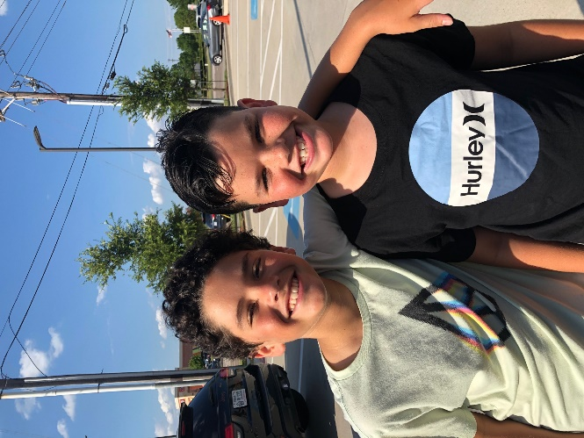









Heather Romero, Engineering Fellow, Raytheon Intelligence & Space
Bachelors in Computer Engineering
Masters in Cyber Security Engineering
  Software engineer
  Field application engineer
  Systems security engineer
  Cyber technology area director
  Customer Engagement
Started at Raytheon in 2004
Love to ski and rock climb
My 2 boys!
Moved to Texas in 2019
Stayed in CA after college
Grew up in Montana
School logos from calpoly.edu & usc.edu
Notes:
CalPoly logo from: calpoly.edu
USC logo from: usc.edu

Slide 3
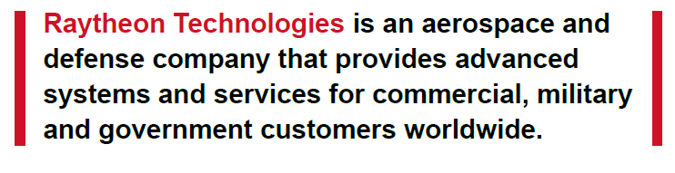
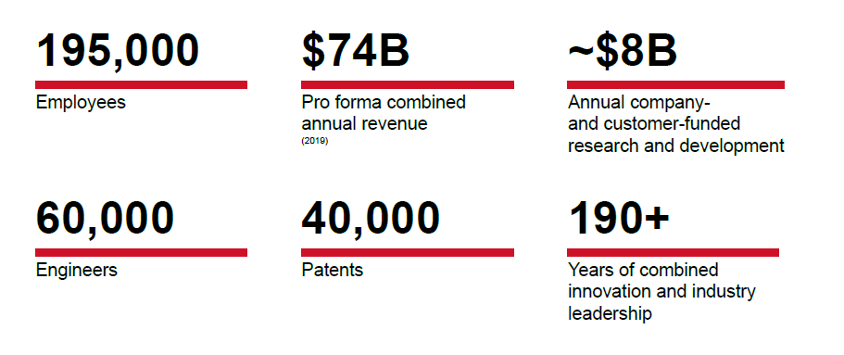

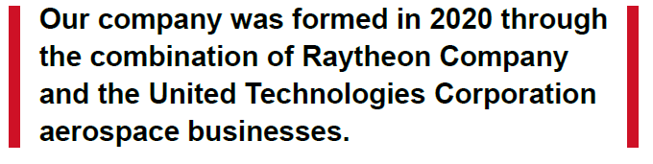
Raytheon Technologies
Photos compliments of Raytheon Technologies
Notes:
From General RTX presentation
Photos compliments of Raytheon Technologies

Slide 4
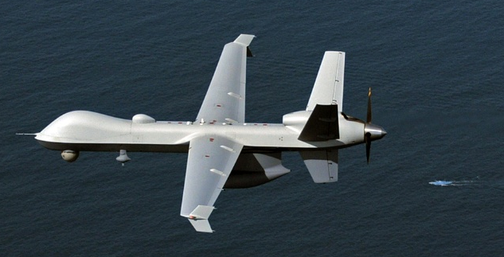
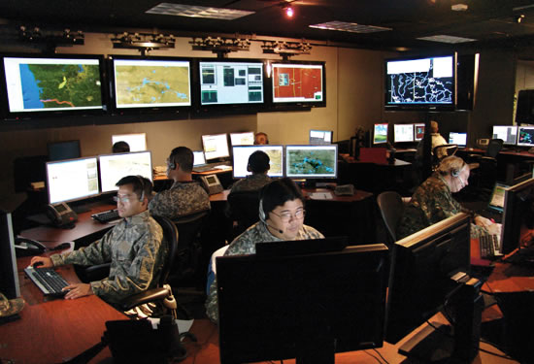
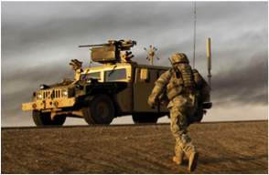
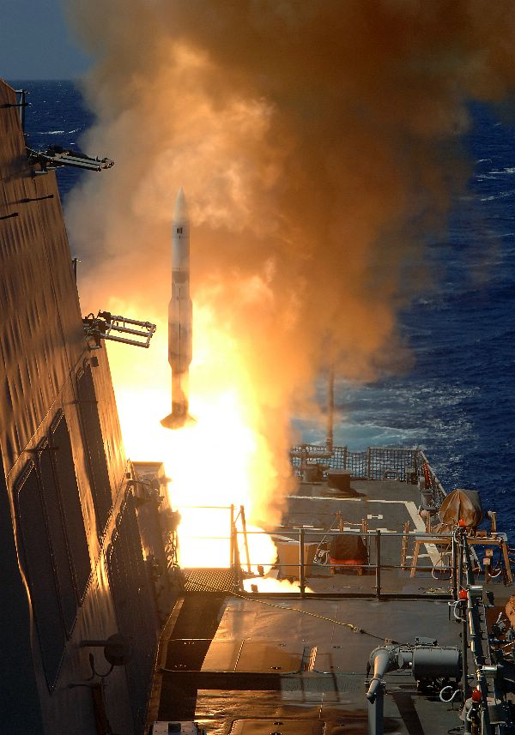
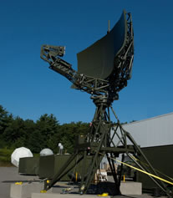


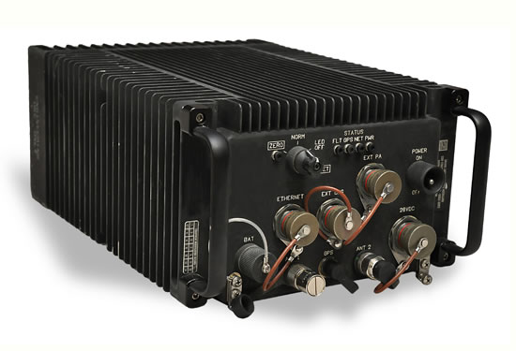
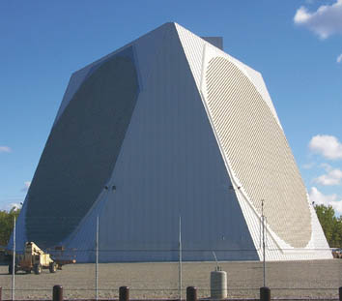

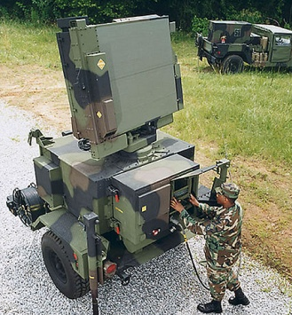


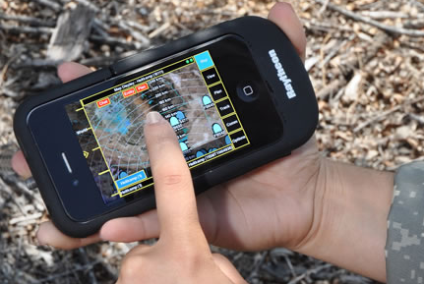
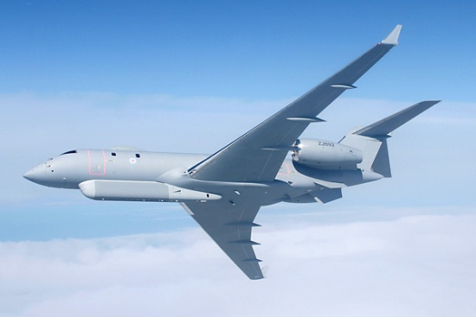
Raytheon’s Footprint in Cyber Space
PhotoUS Navy
PhotoUS Navy
Cyber is part of everything Raytheon Technologies delivers
Photos compliments of Raytheon Technologies
Notes:
FromIIS presentation approved through ETPCR eTPCR_IDS-09507
Photos compliments of Raytheon Technologies

Slide 5






Cyber by the Numbers
Thousands of cyber and special mission experts world-wide
>$4 Billion
#1
30%
Identify and fix system
vulnerabilities
at customer sites
Invested in cyber R&D, infrastructure, and acquisitions in 10 years
57%
18
>500 Million
tests per week
Clearances at or above DoD top secret
Cyber and analytics acquisitions across Raytheon
300+ vulnerability research team
Champion the development of
Cyber talent and leaders
1600+
Cyber professionals across Raytheon
400+
Contracts
Including
DHS DOMino
DHS HIRT
CARTWRIGHT
Customers in 80
24 cyber
locations
worldwide
countries
2020 Wins for:
Hack-a-Sat - SAR CTF
Hack the Machine - Hack the Vote (2nd)
A leader in
Next-generation
Most of our best work is classified
high-consequence missions
Providing secure solutions for Raytheon, government customers, commercial and international partners

Slide 6
Cyber~1600 Across RTX
State College
Greater Boston & Portsmouth
Cambridge
Cedar Rapids
Ft. Wayne
Aurora/COS
RTRC, East Hartford
Sunnyvale
CODE, Dulles Area
Arlington
Columbia/AJ
Annapolis
Double click on map to colorize individual states
Salt Lake City
Indianapolis
International
UK
Cork, Ireland
Rome, Italy
Riyadh, KSA
Orange Co.
McKinney
Cityline
CA Richardson
Morrisville
El Segundo
Tucson
Huntsville
Greenville, SC
Austin
Melbourne
San Antonio
Largo/St. Pete
Sites with ≥ 10 Cyber engineers and scientists

Slide 7



RIS Cyber Training and Services Catalog
Products
Tangible item that is configuration controlled and managed as a deliverable through a sales channel (sell or resell)
Technology
Tangible item (SW and/or HW) that is configuration controlled and managed as a component to include
in solutions (OEM, “white label”)
Cyber resiliency products (e.g., Iron Shield, EA)
Missions services products (e.g., iFOXII, Gotham)
Windshear advanced drone defense platform
Selective product resell (i.e., Silo, Virsec, nLighten)
Advanced dark web monitoring
Software-based cloud orchestration
Cyber Anomaly Detection System (CADS)
Forensics/malware/penetration
testing labs
Cyber threat hunting
Advanced analytics
Services
Delivery of an intangible outcome via people, logistics or support materials
Capabilities
Essential ability, knowledge or experience,
along with the tools to deliver solutions
Managed SOC
Architectural review for hardening (ARCH)
High performance computing services
Combat support and advisory services
Emulation
Vulnerability research
Vulnerability scanning
DevSecOps pipeline implementation
Combat support and advisory services
Cyber resiliency assessment tools
CNO engineering services
Technology and tools assessment
Mission readiness high fidelity system simulation
Acronyms: Cyber Network Operations (CNO)

Slide 8




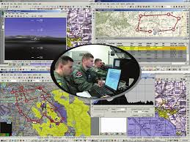
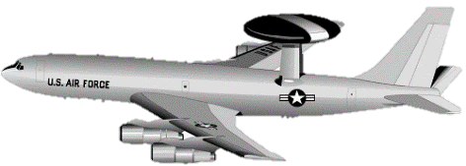



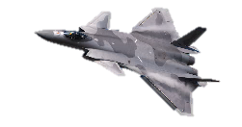

Why is Cyber important?
Geographically-dispersed information systems
Connectivity creates an attack surface for all systems
From design & development to Operations – Need accountability for SW, HW and data through lifecycle
Surveillance/Satellites
Government and Public Data Sources
Fielded Systems
Design &
Development
Operations
System Planning
+
Legacy Systems New Autonomous Systems
Global Challenge

Slide 9
Avionics Security Example

Slide 10






Notional Airframe
Sensing and Communications
Weapon Systems
Aircraft Control
  Satellite Comm’s
  EO/IR pod
  Targeting Systems
  Stores Management
  Smart Weapons
  Cockpit Displays
  Flight & embedded control
  Flight-safety related
  Navigation
Ground Support
and Labs
  Maintenance instruments
  Maintenance personnel
  Data Loaders
  Data Recorders
  Ground Support Networks
  Maintenance & Mission Planning
10
Notes:
FROM: IIS 2015-126 Approved for public release
Presentation Title
Speaker Name

Slide 11
Mis-use Cases*
Unwitting crew member introduces malware via infected personal device or EFB
3
Over-the-air attack on navigation receivers and other data links to inject software payload. Use zero-day vulnerability in nav receiver software
1
2
Compromise software within ground systems (through insider, unsafe connections, etc.) Infect aircraft control system once connected
Malware introduced by maintenance platforms infects stores controller, and from there to weapon
5
Malware spreads laterally from another infected air-craft exploiting implicit trust
4
*All similar to actual incidents we’re seen and/or cases we’ve been able to replicate
11
Notes:
FROM: IIS 2015-126 Approved for public release
Presentation Title
Speaker Name

Slide 12
Vulnerabilities - Typical from our Experience*
2
Controllers / actuators implicitly trust commands on bus.
1
Display processor runs commercial OS – as configured contains multiple vulnerabilities exploitable through USB port; others exploitable over the bus.
4
Smart bomb-rack controller OS found to have a vulnerability to exploit from another component on bus
3
Protocol stack used by network processors in radio suite found to have vulnerability subject to exploit from malformed headers and payloads from another network node (RED side)
* Typical of significant findings we commonly see in our detailed vulnerability assessments. Does not imply actual findings against any specific platform.
12
Notes:
FROM: IIS 2015-126 Approved for public release
Presentation Title
Speaker Name

Slide 13
Cyber Jobs/Skills

Slide 14
Cybersecurity Myths
    Cybersecurity doesn’t apply to us because …
    We have never had to do this before so this doesn’t apply to us
    Incorporating system security into a product can be done separately from the normal development process
    Incorporating security into a product can be done after the fact if we need it
Be an advocate for integrating security
Notes:
eTPCR SAS-18433

Slide 15
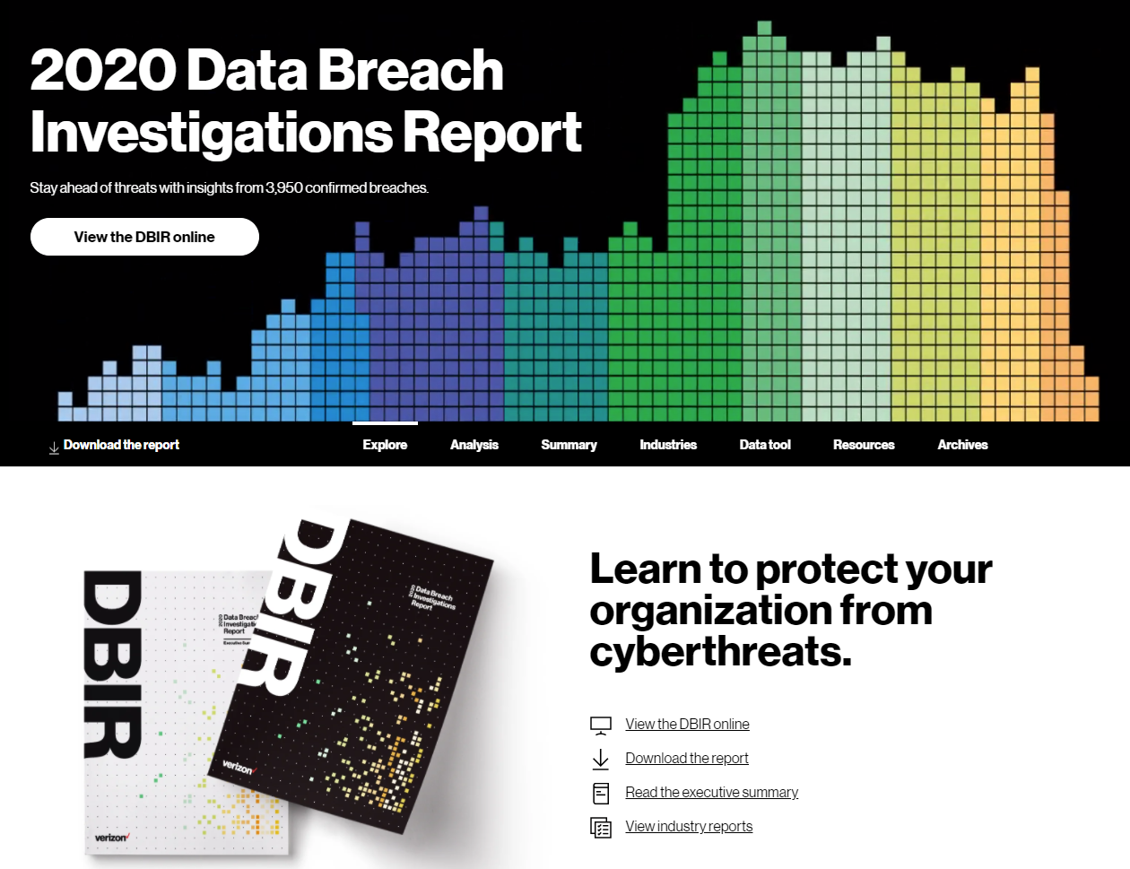
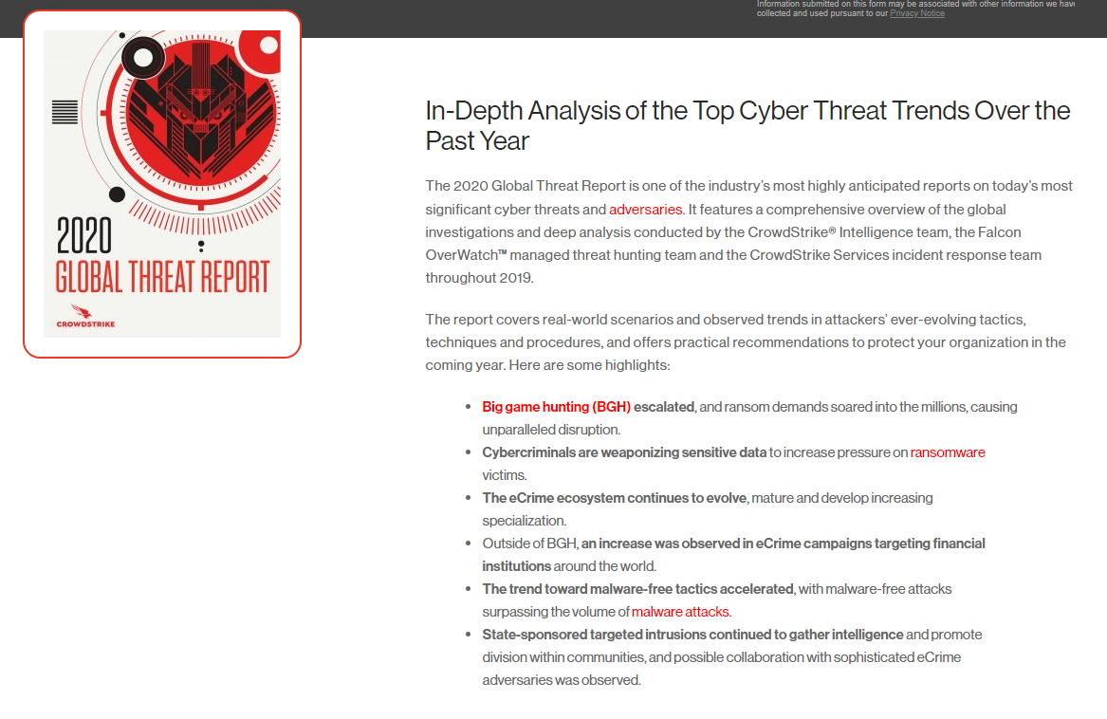

Keeping Current with the Threat
Verizon Data Breach Report https://enterprise.verizon.com/resources/reports/dbir/
Crowdstrike Global Threat Report
https://www.crowdstrike.com/resources/reports/2020-crowdstrike-global-threat-report/
Notes:
eTPCR SAS-18433

Slide 16

Cyber “Hats”
IT / Computer Networks (CISSP)
Enterprise & Embedded Cyber Product Design & Development, R&D
  Hardware & Software
Vulnerability Research (Ethical Hacker)
Security Analyst (Security Operations Center)
  Tier 1 Helpdesk to full blown AI/ML/analytics
Cloud security, DevSecOps, Resiliency & Mitigation Solutions
Cyber threat hunting / threat intelligence
Digital Forensics
Many areas of expertise within Cyber – where do you want to specialize?

Slide 17
Cyber Certifications
CEH: Certified Ethical Hacker
  How to think and act like a hacker: cover hacking technologies, the latest vulnerabilities, information security laws, and standards
CISM (Certified Information Security Manager)
  Top credential for IT professionals in enterprise-level applications for developing the best organizational security practices
CompTIA Security+
  General level certification for those who are new to cyber technology
CISSP (Certified Information Systems Security Professional)
  Many IT organizations consider this certification as an essential requirement for network security
GSEC: GIAC Security Essentials
  Requires five years of relevant work experience. It is an entry-level certification designed for professionals who aspire to occupy ‘hands-on’ security roles.
ECSA: EC-Council Certified Security Analyst
  Similar to the CEH certification. This certification gives you an understanding of hacking tools and the latest technologies.
GPEN: GIAC Penetration Tester
  For personnel whose job duties involve assessing target networks and find security vulnerabilities.
SSCP: Systems Security Certified Practitioner
  Ensures that you have acquired the advanced technical skills to implement, monitor, and administer IT infrastructure using best security practices, procedures, and policies established by the cybersecurity experts.
CRISC: Certified in Risk and Information System Control
  Enterprise risk management qualification for professionals looking forward to extending their knowledge and experience of IT, Business Risk, identification, and implementation of Business Systems Control.
CISA: Certified Information Systems Auditor
  Focuses on Information Auditing.
CCSP: Certified Cloud Security Professional
  Gives IT professionals a deep understanding of cloud architecture, its design, operations, and services.
CHFI: Computer Hacking Forensic Investigator
  Advanced cybersecurity certification for forensic network security investigators.
Top Cyber Certification: https://hackr.io/blog/best-cybersecurity-certification

Slide 18

Classes/Skills for Cyber
Familiarity with Windows and Linux
Understanding of networks/internet/communication protocols
Working knowledge of math and applying “algorithms”
Using cyber “tools” – penetration testing, fuzzers, metaploit, ghidra
Coding
  Python
  C/C++
  Android/iOS
  Java
Be inquisitive and a problem solver!!
Notes:
eTPCR SAS-18433

Slide 19
Questions

