Slide 1
Malware Analysis
April 27, 2021
Presented by:
Greg Madden, CISSP
Information Security Officer
Virtuo Group Corporation

Slide 2

A Little About Me
CISSP, Security + certified
B.S. in Cybersecurity, A.A.S. in Information Technology
Information Security Officer for Virtuo Group Corporation
and acting ISO for multiple clients
US Army Veteran. Satellite Communications Operator
and Arms Room Manager
Over a decade of IT experience
6 years of IT security experience

Slide 3
Learning Objectives
Differentiate the types of malware and associated behaviors
Identify tools and techniques used to analyze malware
Recognize the benefits of virtualization in malware analysis
Understand the process of gathering forensic information
Learn how to identify malicious links and attachments to prevent phishing breaches

Slide 4
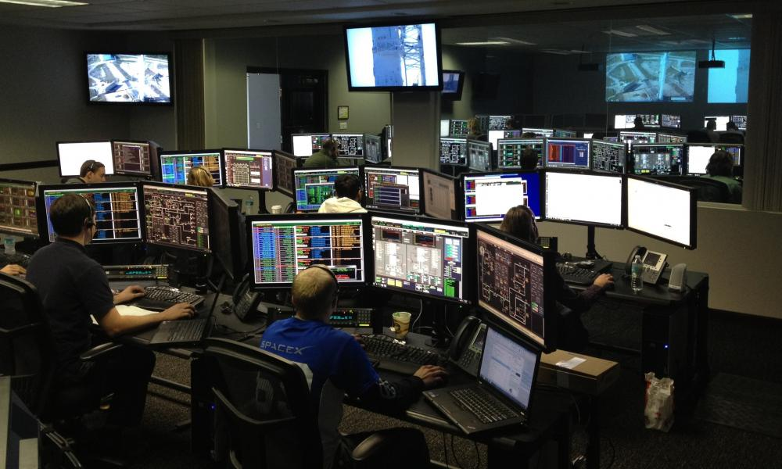
Personal Lab Setup
Do not use personal or work devices to analyze malware
VMware or VirtualBox on standalone machine
No network connectivity to internal network
Secondary email address to forward malicious emails or files for access on the VM
Cheap one-time-use USB drives

Slide 5

Getting Files to Practice
Finding malicious
files to download can be difficult with the built-in security mechanisms on browsers and workstations
Downloading malware is always dangerous and should only be done in a controlled setting – Only download malware samples from reputable resources
Here is a repository of sites that host malware for researches to analyze
YOU are responsible for the malware YOU download
Notes:
https://cyberlab.pacific.edu/resources/malware-samples-for-students

Slide 6

What is Malware?
Virus
Worm
Trojan
Rootkit
Logic Bomb
Spyware/Adware
Fileless Malware
Credential Harvester
Mobile Malware
Notes:
Oftentimes, different malware terms get thrown around or used in place of each other, but to understand malware, you have to recognize the differences in each type of malware. Not every piece of malware is a virus.

Slide 7
Detecting Malware
Signature based
Behavior based
Anomaly based
Notes:
There are a few different methods used to identify malware or malicious behavior. Generally these are done automatically by an IDS or IPS, but when manually analyzing malware, we look for the same things.

Slide 8

Signature Detection
A signature is a unique identifier that is established about a known threat
Examining the hash value of an application
Matching hex code patterns within the machine language of files and applications
Only protects against known threats
Notes:
Every application has a signature. When you run it through a hashing algorithm or when the code is processed into machine language. There are specific hex strings that will follow it. For example, if a piece of malware has instructions to download a certain file from a certain server that is unchanging, that code will be the same every time it runs, and we can look for those specific strings or hex. Signature detection is what you are doing when you scan a document with antivirus or cross reference a hash of a file. It only works against known threats because that signature has to be in a database somewhere.

Slide 9

Behavior Detection
Identify malicious application based on the characteristics of how the application behaves
Recognizing malicious behavior
Reaching out to CnC servers
Modifying files
Requesting unnecessary privileges
Can detect unknown strains of malware
Notes:
Behavior analysis goes a little further and looks at what an application does to determine if it may be malicious. For example, if you open a word document and there is code in there that tries to start another process and download something from the internet, even if this strain of malware has never been seen before, the behavior of the application appears malicious so it can be stopped. In manual detection we can look at things like dropped files or separate processes that may have spawned. Because we are looking at the behavior, we can detect zero-day attacks or previously unknown malware.

Slide 10

Anomaly Detection
Establishes “normal” baseline and compares new files and network activity to the baseline
Which IPs are generally communicating
on the network?
What servers do workstations generally communicate with?
What resources do programs normally use?
Requests outside of the baseline raise alarms
or block the requests
Can detect unknown strains of malware
Notes:
Anomaly detection is often confused with behavior detection but anomaly detection specifically looks for any activity out of the normal. For example, when you open a web browser, traffic to the default home page is generated, but if additional traffic that isn’t normally generated is seen, anomaly detection will alarm that whatever is happening is different than what normally happens. It isn’t looking for specific behaviors, but rather any behavior that is different from the baseline. In the context of manual analysis, we do not generally use anomaly detection, but if you analyze malware and find a behavior you’ve never seen before, it can help you identify new strains of malware.

Slide 11

Analyzing Malware
Static Analysis
Dynamic Analysis
Notes:
Now that we know how malware can be detected, how do we begin analyzing it? There are 2 methods of malware analysis, static and dynamic. There are plenty of free tools to do both, but before we look into it too deeply, there is one concept you must understand. Not all malware can be analyzed the same way. Some malware authors take great caution in hiding the real activities in their malware. This is called obfuscation.

Slide 12
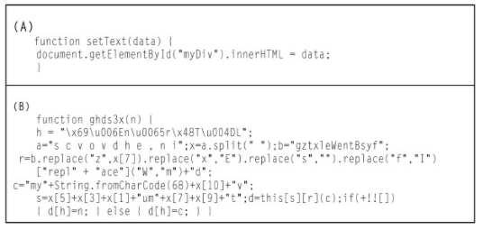
Malware Obfuscation
Malware is packed, compressed, or otherwise manipulated to make detection and analysis more difficult
Hide strings within variables
Make reading the code more difficult
10 + 10 = 20
(5^2-(8.56+6.44))+(3^3(12/6)-sqrt(64)) = 20
Hinders Static Analysis
Notes:
Obfuscation is the process of hiding or concealing code to make it more difficult to analyze. Rather than type out the word hello, you may create a 4 variables, 1, 2, 3, 4 and store the letters as variables so the code doesn’t say hello outright, but 12334 instead or however you do it. The goal is to make the code more difficult to read if a security professional is able to view the source code. If malware is obfuscated, static analysis can be almost impossible.

Slide 13
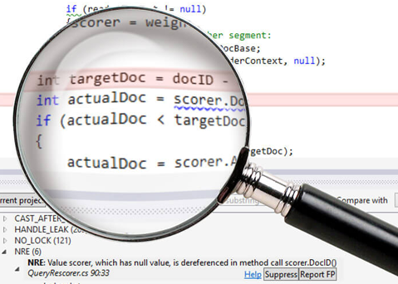
Static Analysis
Collecting information about a file
without running it
Identifying Indicators or Compromise(IoC)
IP Addresses
Malicious signatures
Protocols
URLs
Strings
File Hashes
Hundreds of free tools to automate
static analysis
Notes:
Static analysis is the act of gathering information about an application or file without actually running it. This can be as simple as looking at the file extension or as detailed as using tools to search for specific malicious indicators in the code. One of the purposes of static analysis is to identify Indicators of Compromise, or IoCs. These can be IP addresses, strings, file names, etc. Anything that could be used to identify the malware or the malware behavior is called an IoC. If for example, you uncover an IP address in a file, you can search that IP, and if its malicious, you know the file is likely malicious. That is static analysis at a very basic level. There are tons of free tools you can use to statically analyze malware and we are going to talk about a few today.

Slide 14

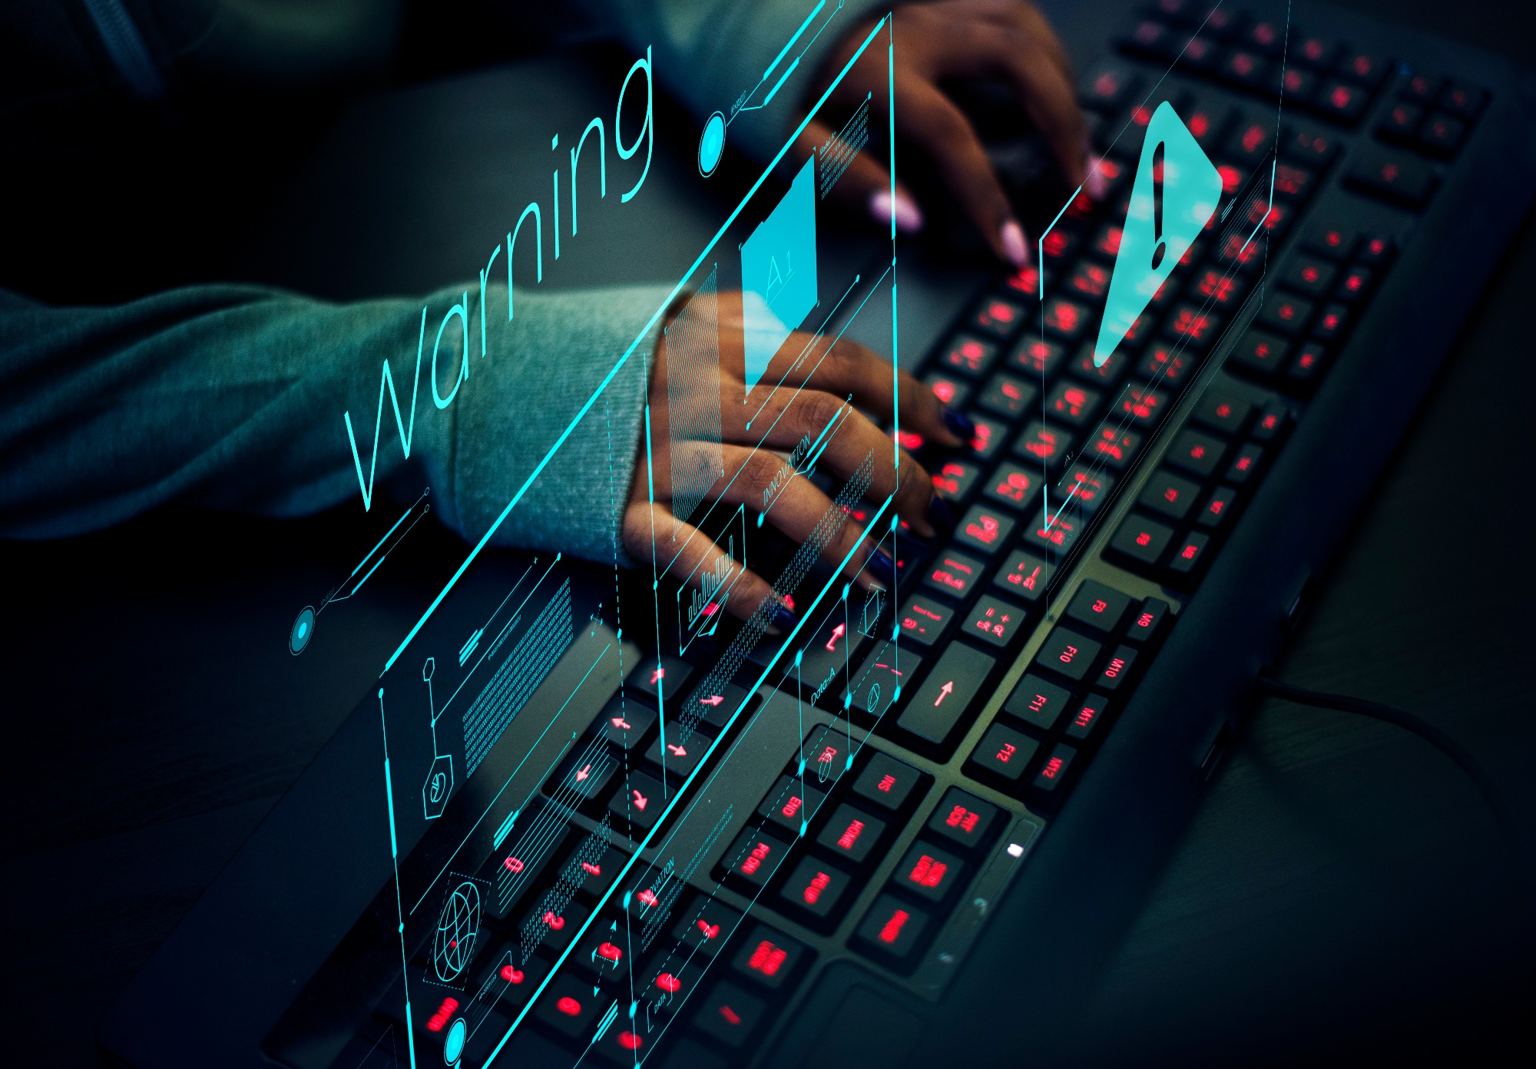
Static Analysis Tools
Antivirus
Hash Values
Hex Dump
VirusTotal
Notes:
One of the most basic forms of static analysis is simply running an antivirus check on a file. This will check to see if the file has any signatures that match known malware, but static analysis goes well beyond that.

Slide 15
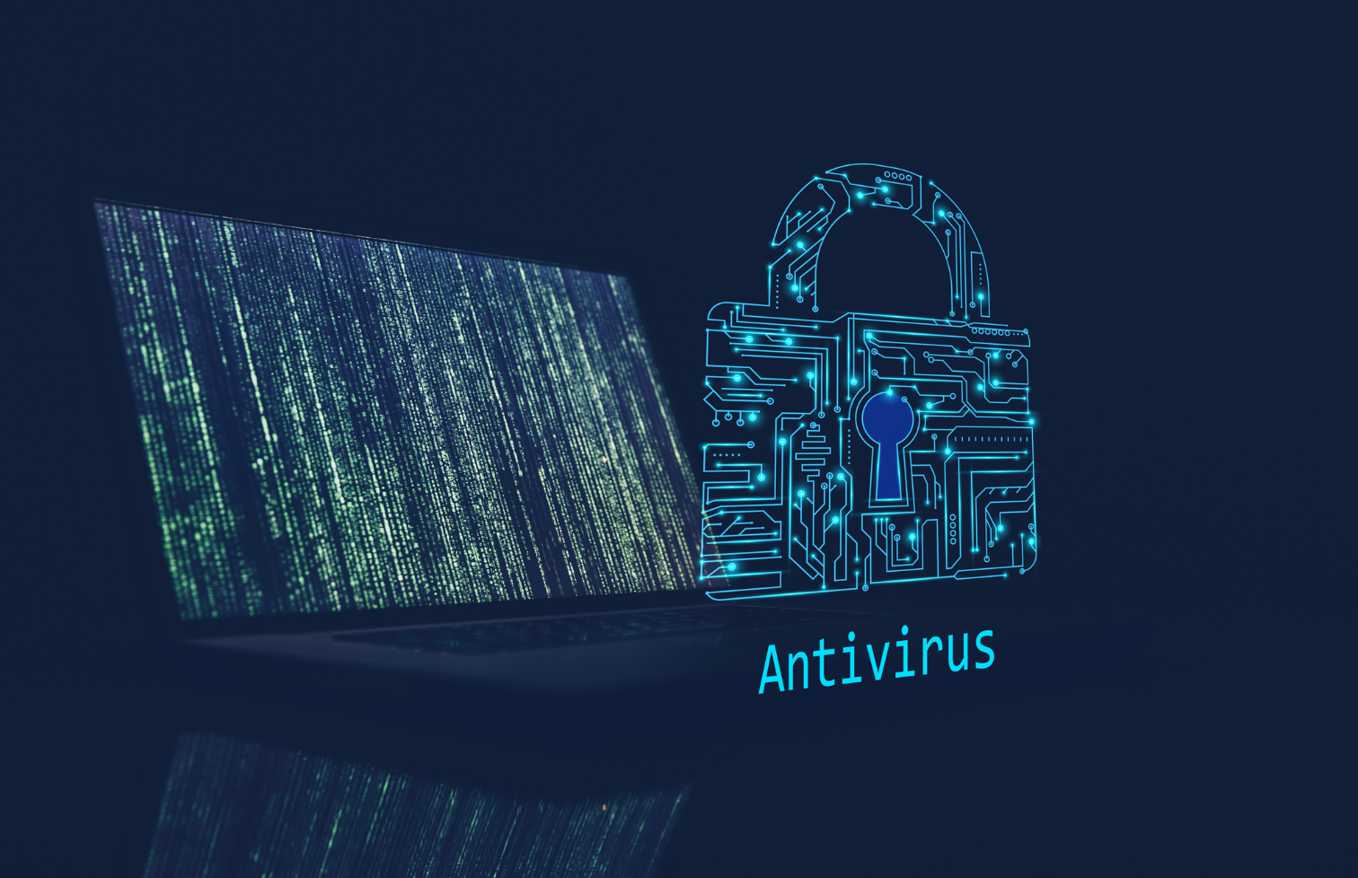
Antivirus
Manually scan the suspicious file
Analyzes known malicious signatures
Not all Antiviruses are the same
Advanced antivirus can also perform behavior and anomaly-based detection
Notes:
Again, the easiest form of malware analysis to get into, right click the file and scan. While most antivirus simply uses a database of malicious signature to cross reference, more advanced antivirus can perform behavior and anomaly detection as well. Its also worth noting that not all antivirus engines are created equal. Some Antivirus vendors perform daily signature updates, some perform hourly updates, and then some do weekly. Knowing the frequency of your signature updates is important in determining how fresh your signatures are and how quickly they can detect newly released malware.

Slide 16

Hash Values
Hashing is one-way encryption to create
a data fingerprint
Fixed length hash value regardless
of message or file size
Get-FileHash C:\Users\sphil\Desktop\ship.jpg
Chance of collision in SHA256 is 1
in 4.3 x 10^-60
Play video
Demo
Notes:
Hashing is a way to create a single signature of a file that will never change so long as the file or application itself doesn’t change. This means that if you take the hash from a piece of malware, as long as the code doesn’t change, that specific piece of malware will create the same hash every time. This can be useful not only in identifying malicious files, but also ensuring the files you download haven’t been altered in anyway

Slide 17
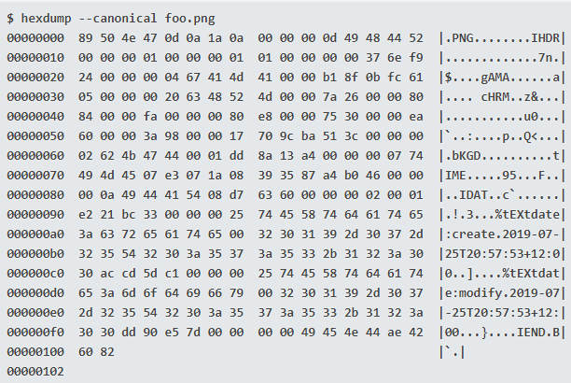
Hex Dump
Review the machine language of the program to identify information about the file
Identify file types
Built-in in most Linux distributions
Hexinator for windows
Demo
Play video
Notes:
As mentioned in the signature detection slide, every application will be translated to machine language when in use and this is annotated in hex. With tools like hex dump, we can view that machine language of a file or application to look for signs of malware. You can gather a lot of information about files by reviewing their source hex dump.

Slide 18
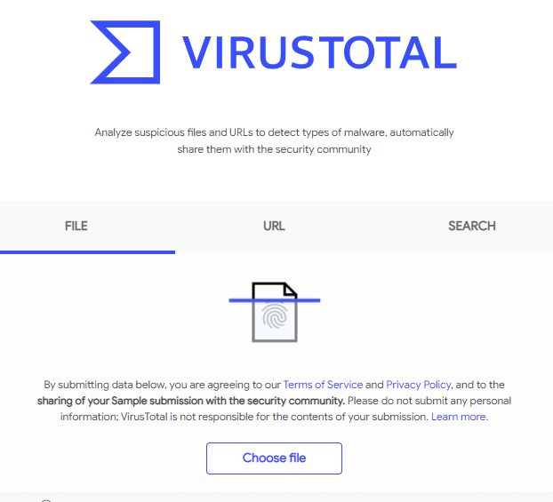
Virus Total
Runs Virus scan from 60 different antivirus engines to detect all kinds of known malware
Checks files, URLs, and other IoCs
Community feedback on suspected malware and malicious IoCs
Incorporated into many malware analysis tools
Play video
Demo
Notes:
If antivirus is the first step in static analysis, why use 1 scanner when you can use 60? Virus total will run files or IoCs through over 60 different antivirus engines to identify malware. Signatures that may be on only a few av engines but not all will allow you to search and cross reference against them all. Beyond just dropping a file or application, you can search for any and all IoCs: hash values, URLs, IP addresses, etc. Because it is so useful, many static and dynamic analysis tools use virus total at some level to identify the basics of a file.

Slide 19

Dynamic
Malware Analysis
Sandbox
Process Explorer
Procmon
RegShot
Virtual Network
Wireshark
Honeypot
Notes:
Now that we’ve looked at static analysis, lets look at dynamic analysis and all the tools we can use to perform it.

Slide 20
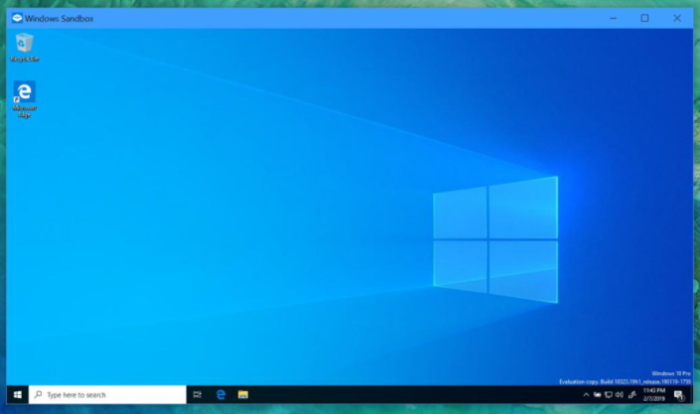
Sandbox
What happens when you run the application?
Are there any popups?
What new processes do you see?
Are there any changes to critical
operating system files?
Windows Sandbox
Windows 10 Pro or Enterprise
Enabled in Windows features
Falcon Sandbox
Automated static and Dynamic analysis
Demo
Play video
Notes:
A sandbox is a secure environment where you can run suspected malware without the risk of the malware tearing through your networks. You can setup a standalone laptop, you can build a virtual subnet to test, windows has a built-in sandbox and there are also 3rd party sandboxes you can use. The purpose of the sandbox is to allow you to look at what a file does when it is run, things you cannot see with static analysis like new services that are run or files that are installed. For this demo, I am going to show you how Falcon Sandbox works. It is an automated tool that will perform dynamic analysis for you and simply spit out a report for you to use.

Slide 21
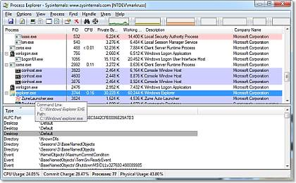
Process Explorer
Super-charged task manager
Displays running processes in tree format
Identifies process names, icons,
processor time, etc.
Connects processes to applications
Allows you to look up process name in Google
Process Explorer
Notes:
If you are wanting more hand on dynamic analysis, one tool you can use is called process monitor. It is essentially task manager on steroids. It displays process information in great detail, laying out hierarchal information and connecting processes to services or applications, it also allows you to search the process with google.

Slide 22
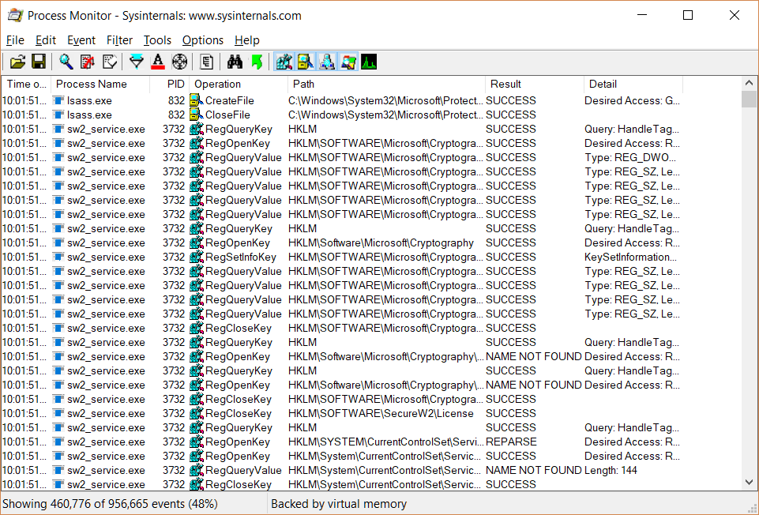
Procmon
Process Monitor
Identify child or parent processes launches
when an application run
Used for real-time application process analysis
Track new processes and registry settings
Log resource requests and whether access was denied or granted
Procmon
Notes:
Procmon or process monitor is used for real time analysis of process changes. Where explorer lets you see everything, procmon allows you to identify only new processes or only look at specific registry changes. Procmon and process explorer are often used in conjunction with each other, but proc mon makes more obvious the changes to a system as opposed to just displaying detail about the system.

Slide 23
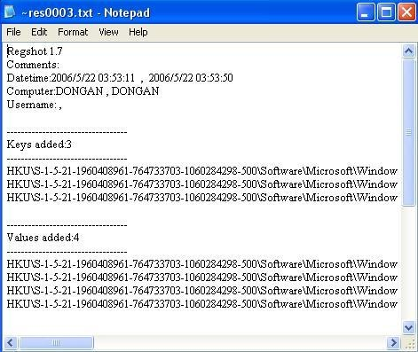
RegShot
RegShot captures snapshot of registry settings
Malware often changes registry keys and created new ones
Compare registry configurations before and after running malware
Notes:
RegShot is a tool that essentially captures a screen shot of your registry settings. In a sandbox setting, you could capture the settings and rerun RegShot after you run the malware to determine if any reg settings had changed.

Slide 24

Virtual Network
Some malware expects to see certain services or network resources before it will launch malicious activities
Set up a local web server so malware can reach out to port 80 to relay information
INetSIM is as Linux tool that emulates common network services
ApateDNS spoofs DNS responses from specified IP addresses
Notes:
We have talked about specific tools so far, but to truly analyze malware, you need a full virtual network. As ive already mentioned, some malware will look for specific identifiers to determine if a host is real or if its on a sandbox. Malware may look for open ports or network traffic. You can setup and build a virtual network that mimics a real network which will allow you to ensure the malware you are looking at activates as it should. If the malware detectes it is in a fake or sanitized environment, it wont do what it is supposed to which may lead to a false negative which is way worse than a false positive.

Slide 25
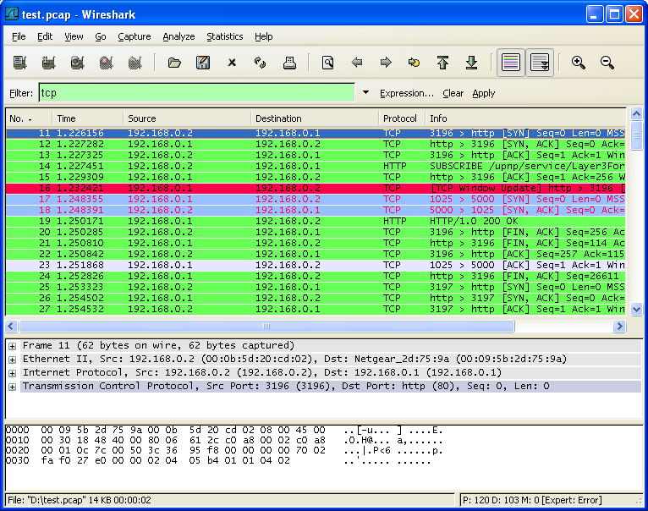
Wireshark
Identify which IPs malware reaches out to
Recognize file requests and which
protocols were used
Uncover network propagation techniques
Pinpoint infection vectors
WireShark
Play video
Demo
Notes:
Another useful tool for malware analysis is Wireshark, because malware often reaches out to malicious servers to download additional malware or get instructions from attackers, identifying the network connections a machine makes when malware is run is crucial in identifying the source of a malware to block it outright. You can also use tools like wirshark to capture files being downloaded over the internet or see if sensitive data is leaving the network. The demo here is just a brief overview of the interface and how a capture works, but when it comes to malware analysis, you can dive deep into wireshark and other traffic analyzers.

Slide 26
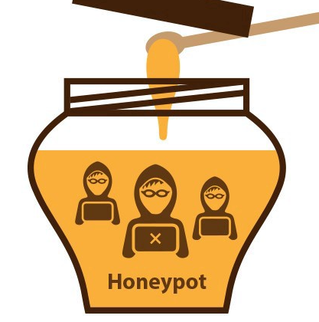
Honeypot
Mimics a vulnerable target to entice attackers away from critical resources
Can be used to detect attacks on the DMZ before they get inside the network
Gather information about attacker methodology in real-time
Different kinds for different analysis
Web servers
Database servers
Email servers
Notes:
A honeypot is just a trap to either study attackers or at the least lure them away from your critical assets. Advanced malware hunters can utilize honeypots to analyze attacker behavior well beyond just malware. You can use them to see the exact methodology attackers use, what do they scan first, what protocols are they using, what applications are they targeting? All of this can be used to develop better security against attackers as a whole. There are different types of honeypots depending on what youre wanting to examine, but the end goal is usually to keep an attacker busy playing with useless databases while alarming you to their presence so you can block them from ever getting into your network.

Slide 27
Static Analysis Methodology
Scan
with local Antivirus
Upload to VirusTotal
Take hash values
Search for malicious strings
Check file in Sandbox
Investigate IOCs found in each step

Slide 28
Dynamic Analysis Methodology
Take a full snapshot of the machine prior to conducting dynamic analysis
Take registry snapshot with RegShot
Turn on process monitor and explorer
Prepare TCPView
Set up virtual network
Begin capturing packets with Wireshark
Run
malware

Slide 29

Identifying Malicious Emails
Notes:
One of the most common use cases for malware analysis come in suspected malicious emails so we are going to look at a few ways to analyze emails for malicious indicators.

Slide 30
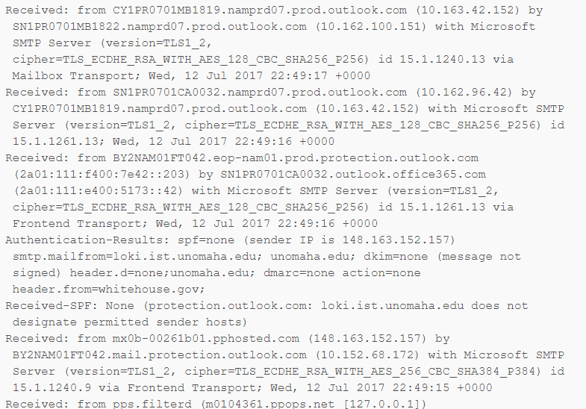
Email Headers
Mismatched Sender Address
Email Travel Path
Email Client
Demo
Play video
Notes:
The original header tells you all you need to know about an emails travel to the designated inbox. You can tell if the sender email was spoofed, you can tell where the email originated, which email client was used to send it, and the path the email took.

Slide 31
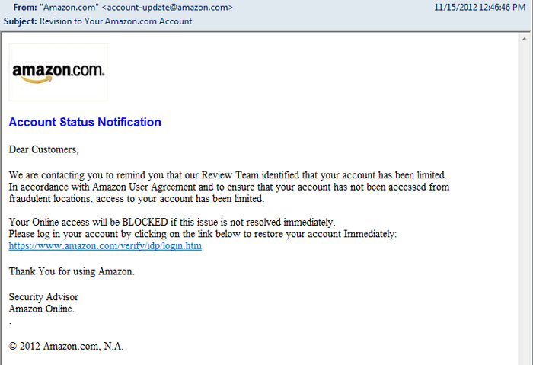
Links
VirusTotal
Scanurl
Website Screenshots
CheckShortURL
Notes:
You can also copy the links from an email and analyze them into a URL scanner. Virus total is an obvious go to, but there are other tools as well. ScanURL will open a link for you, you can utilize tools to capture screenshots of a link to determine if they appear malicious, you can also resolve shortened URLs to their real destination. When all else fails, you can open a link within a sandbox.

Slide 32
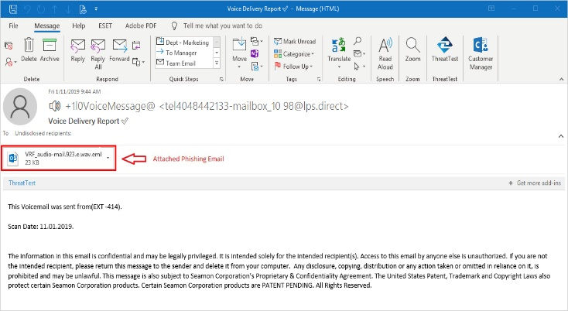
Attachments
VirusTotal
Falcon Sandbox
PE Studio
Beware of multiple extensions
Notes:
With attachments, again we first throw it into virustotal, but we don’t stop there. Just because a signature isn’t detected yet, doesn’t mean it isn’t malicious, so we can import the attachment into falcon sandbox or PE studio to identify malicious signatures. Also, if you see multiple extensions like in the example here, you can generally assume it is malicious.

Slide 33

Digital Forensics Process
Seize Device
Data Acquisition
Forensic Analysis
Reporting
Notes:
We cannot discuss incident response investigations without also mentioned digital forensics. I have already mentioned collecting evidence, but there are certain steps to take when an incident occurs. The first thing to do when malware is found is to seize the device. That device cannot be left on the network, and if it was with a user at the time, like a laptop, you need to gain custody of it immediately so that no evidence of any wrong doing can be deleted. Once you have the device, if you find you’re dealing with more than just an accidental phishing download, you need to get the data off the device for investigative purposes. For example, if an employee intentionally installed malware, you need to gave that data so you can press charges or sue for damages. The process once the data is copied is forensic analysis, and without a lot of training, it’s not something everyone can do with ease. There are premade tools you can use for analysis, but without understanding what you are looking for or how to use them, it is tedious. Many organizations contract with a 3rd party before an incident ever occurs so that they can send the laptop to them for analysis because keeping a full time forensic analyst on staff can be pricey. Finally, once you or a vendor you use analyzes the devices, a report will be generated outlining all pertinant information related to the incident. Things like timestamps, usernames, file paths, registry settings, etc.

Slide 34
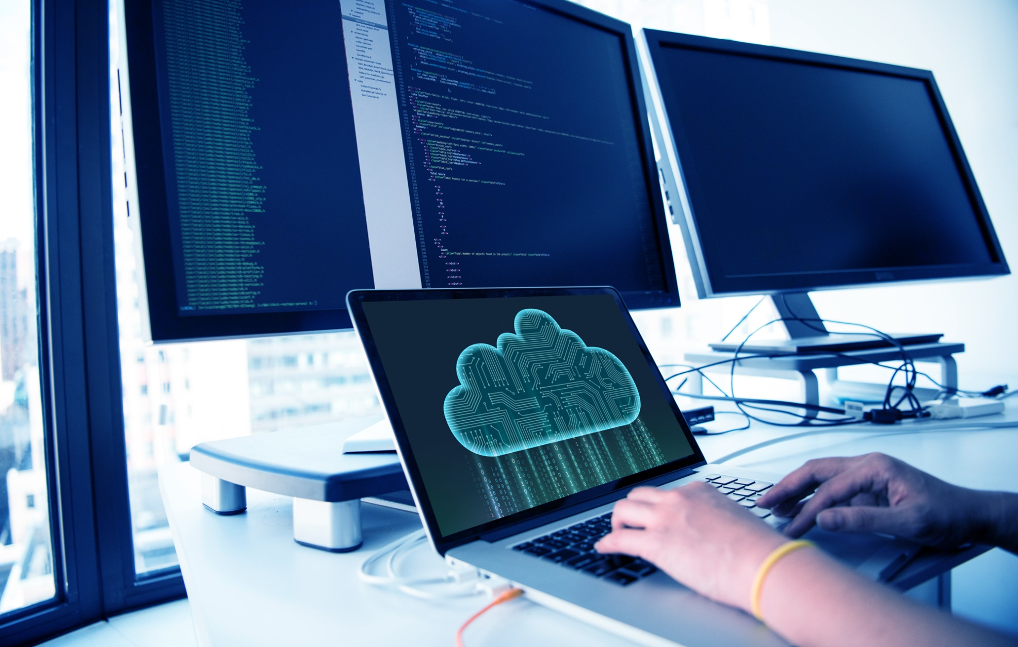
Data Acquisition
What to capture
RAM
Hard Drive(s)
Processes
Browsing History
Network Connections
Clipboard Contents
FTK Imager
Create Forensic image of computer data
Captures volatile memory
Generates hash for regular files and disk images
Notes:
In our lab, we are going to do some basic data acquisition, so you should be aware of the concepts. We aren’t only looking for malicious files, we can be looking for malicious code copied into the clipboard, we may need to see what was on the memory prior to a crash. We have to capture every piece of information about a machine, not just the hard drive. Again there are tons of tools that do this for you, but one I have used in working with forensics is FTK imager. It not only creates forensic images for you, it catalogues it as evidence with a chain of command that will allow your data to be admissible in court. When it comes to a forensic investigation, you can’t just clone a hard drive and bring it in. digital evidence is still evidence and must br treated as such, a complete chronological list of who maintained custody at all times must be followed, this is called the chain of custody, and without it, your data will not be allowed in court.

Slide 35
Conclusions
There are dozens of free tools to begin analyzing malware
Practicing can be difficult but should always be done on virtual environment
Some malware is more dangerous than others
VirusTotal provides instant scans from dozens of antivirus engines
Malware is often obfuscated to make analysis more difficult
Capture infected images for further forensics

Slide 36

Questions

