Slide 1
Is There Life After [Finishing] School?

Slide 2
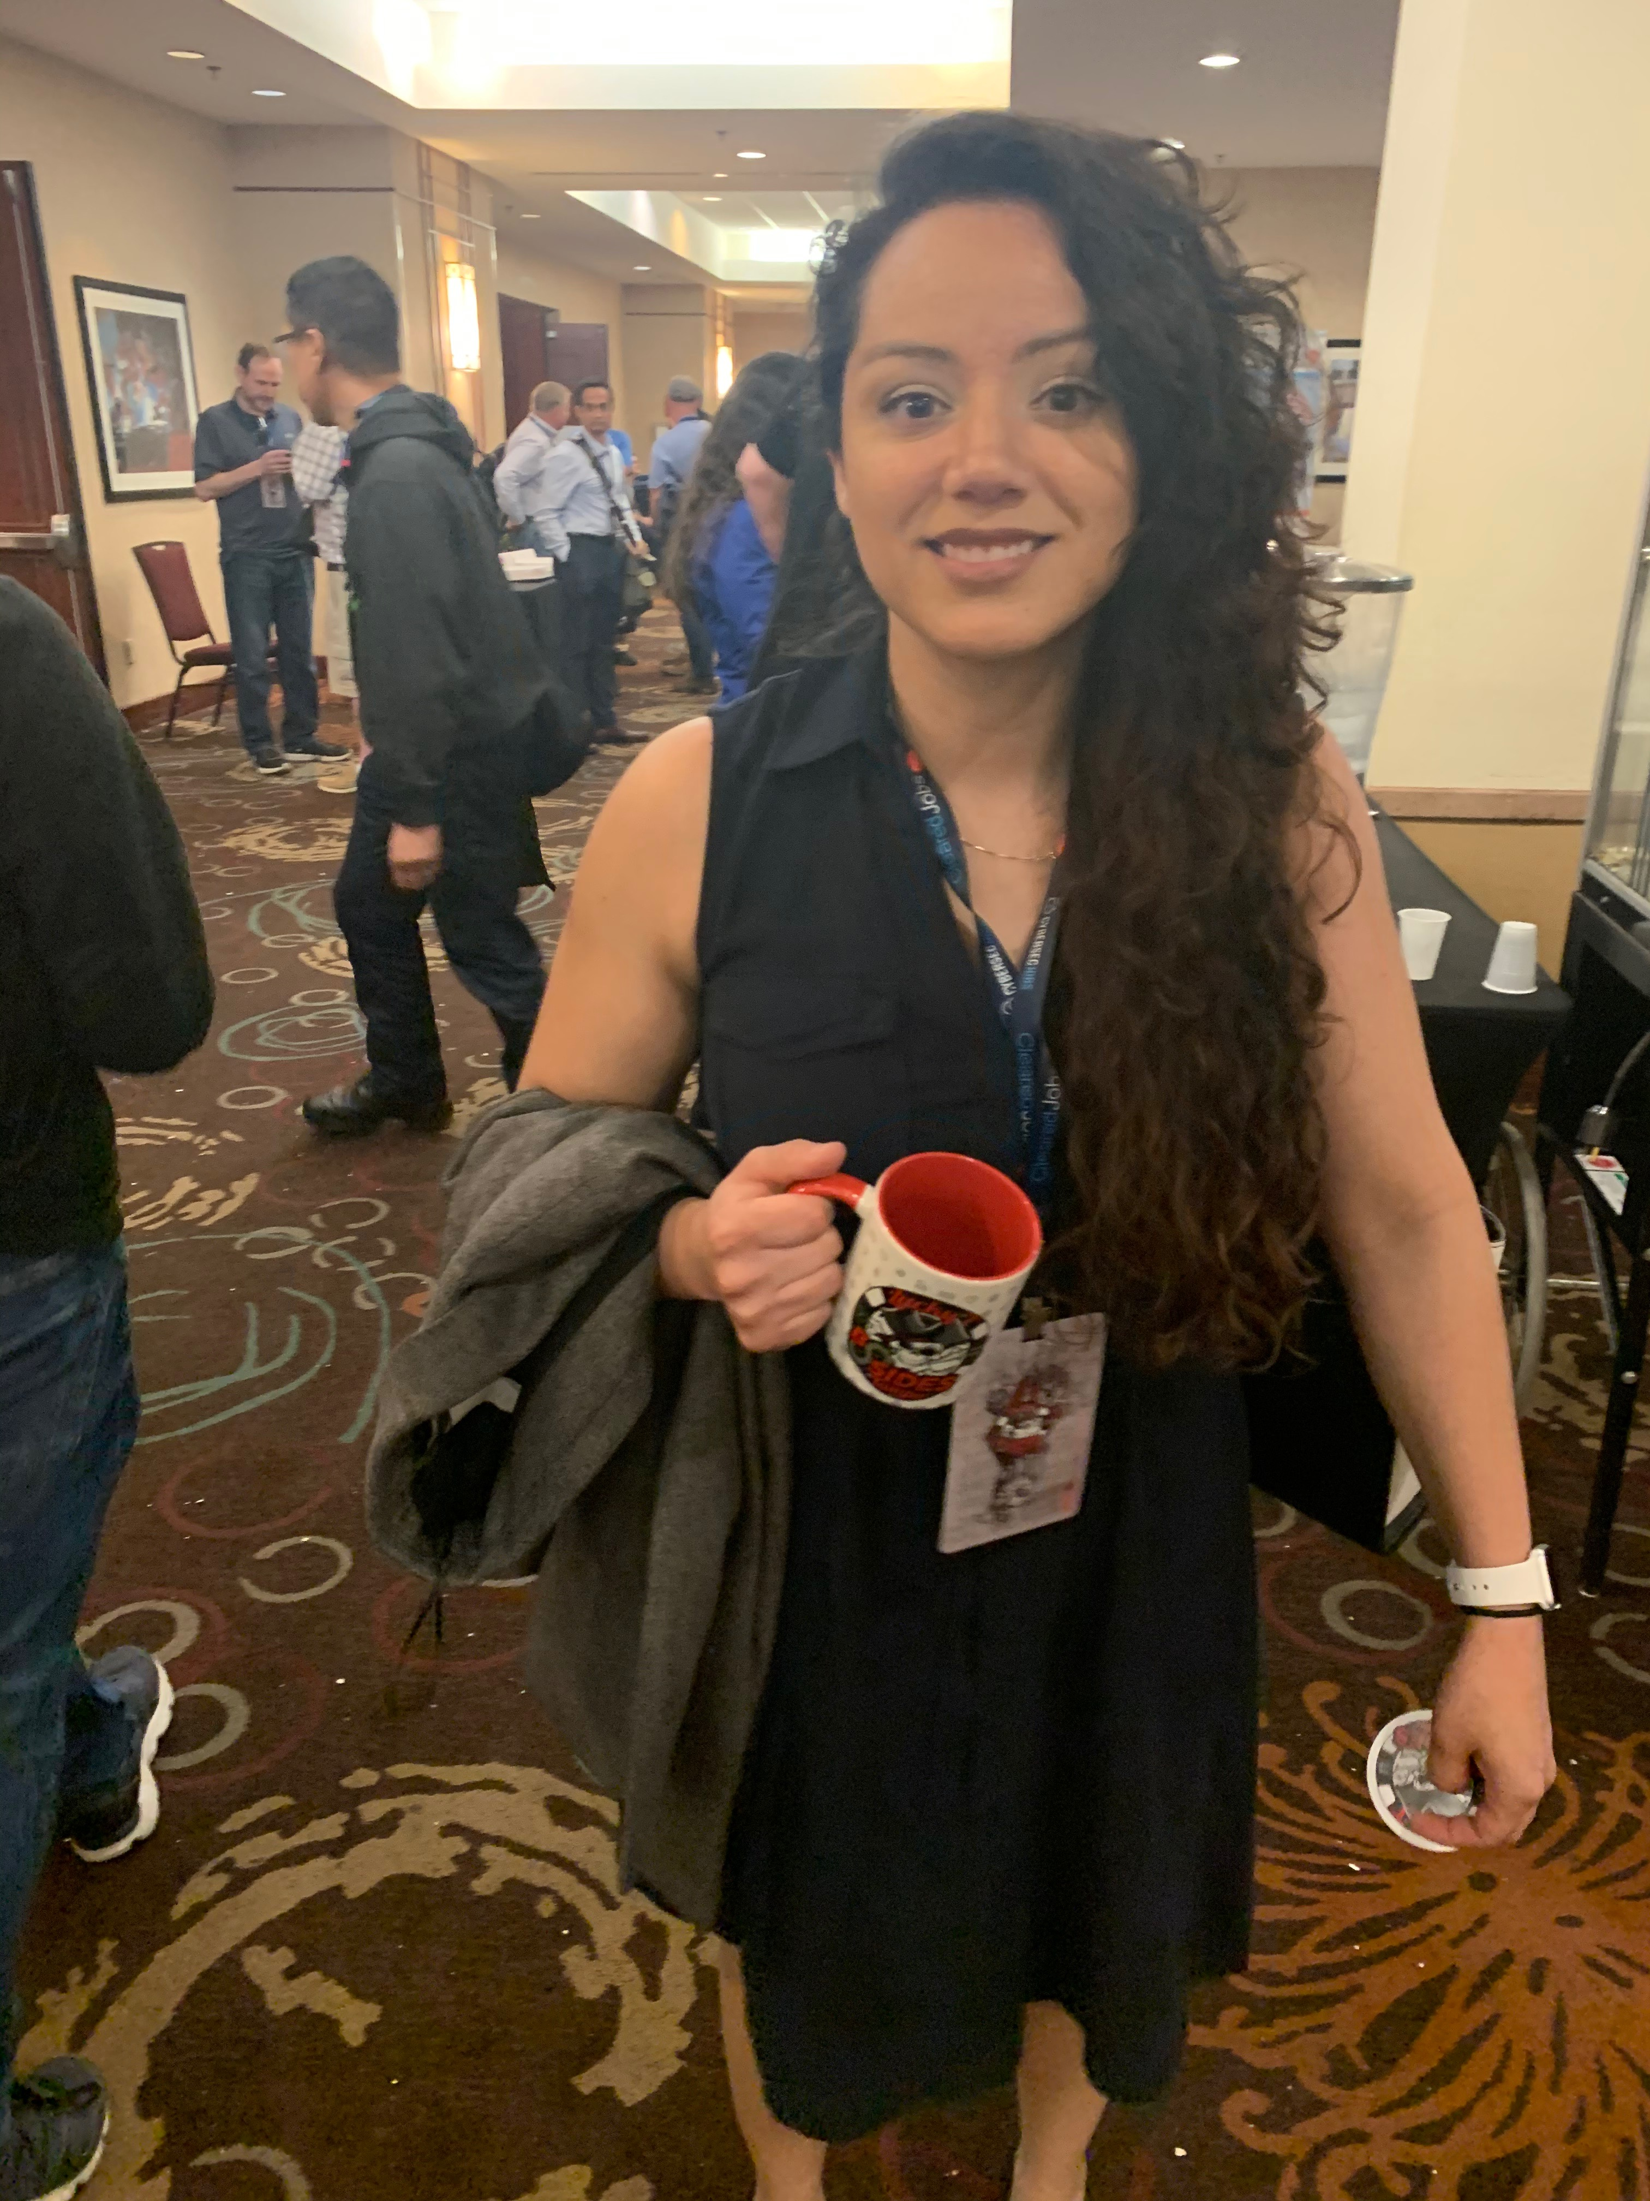

Hello!
I am Nelly Mulleneaux
Double-Round (Bachelor and Master) Alumni of

Slide 3
My Ethos
(AKA Why You Can Trust Me)
I am a Senior Tech Writer at the VA
I am negotiating a six-figure position as Program Manager
I get hit with offers on LinkedIn all the time
Not bad for 13 months after finishing my undergrad, huh?

Slide 4

At First, I Was Afraid
I Was
Petrified
Kept thinking I could never make it because this field is hard
But I spent so many nights applying for internships and jobs
And I grew strong
And learned how to type some code
I know SYN-ACK
Know SYN-SYN-ACK…
You get the point…

Slide 5
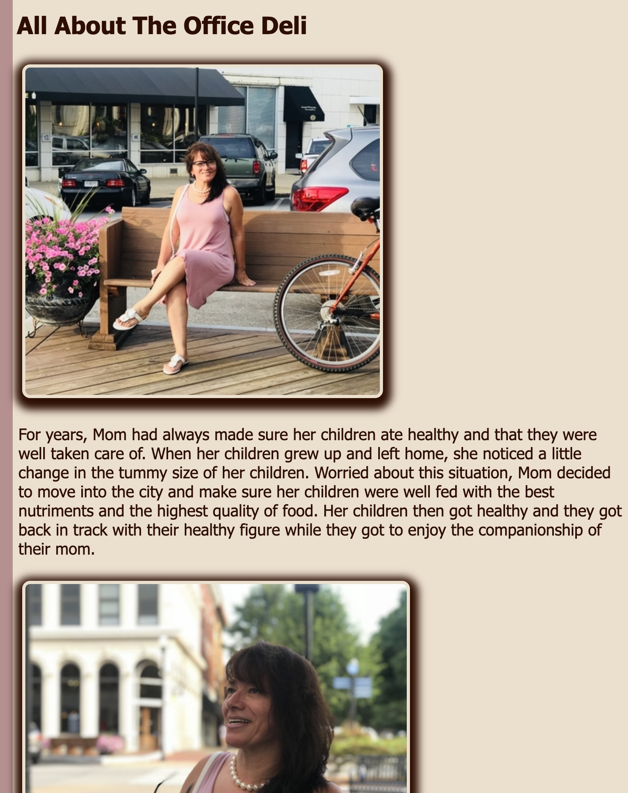
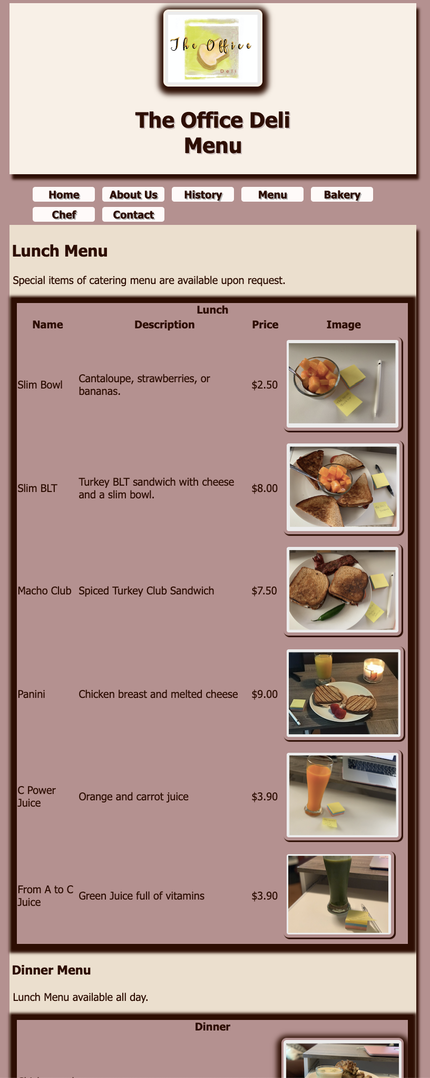
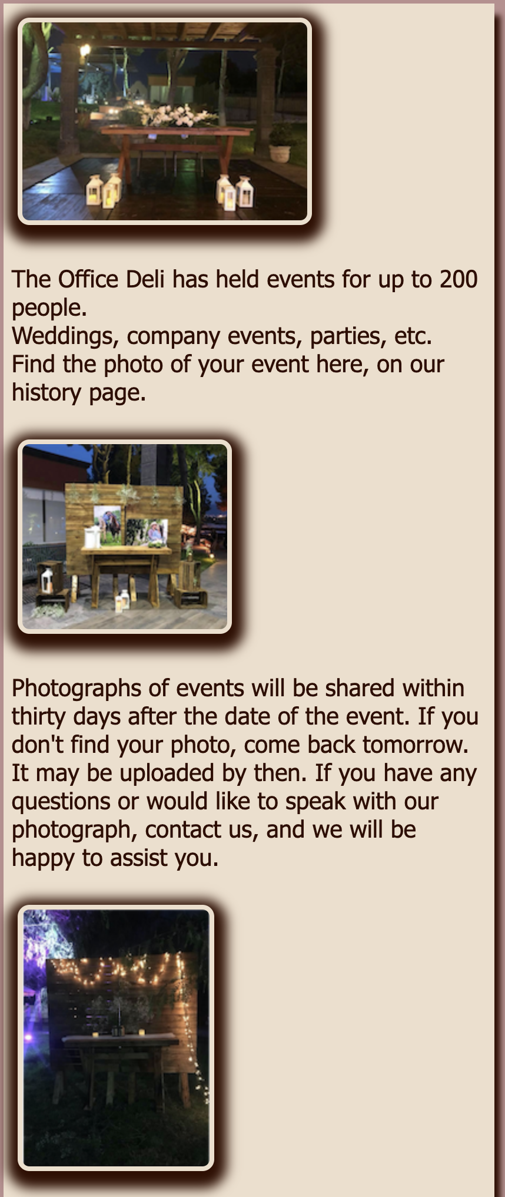

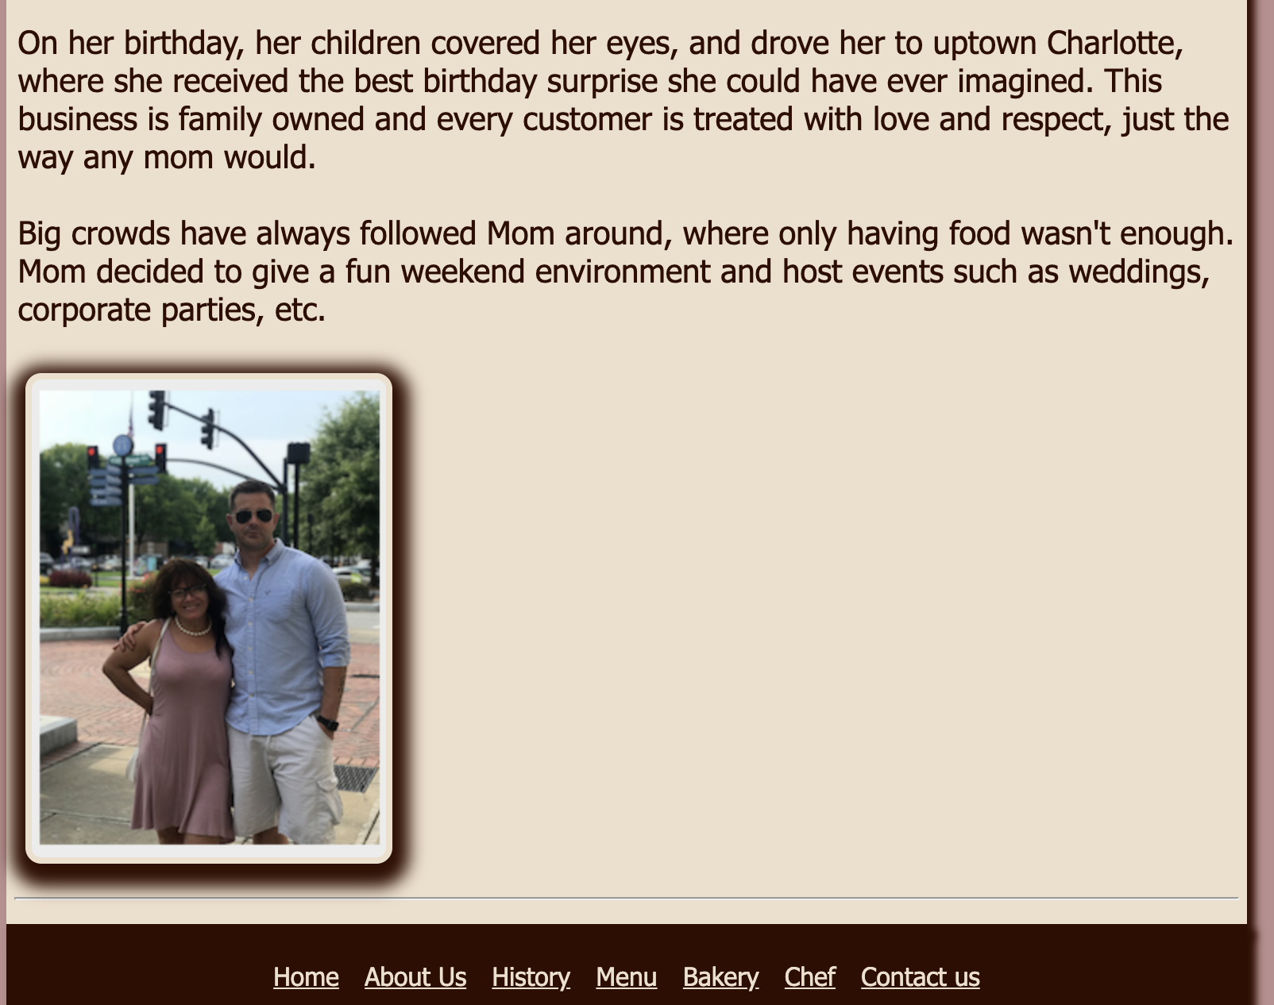
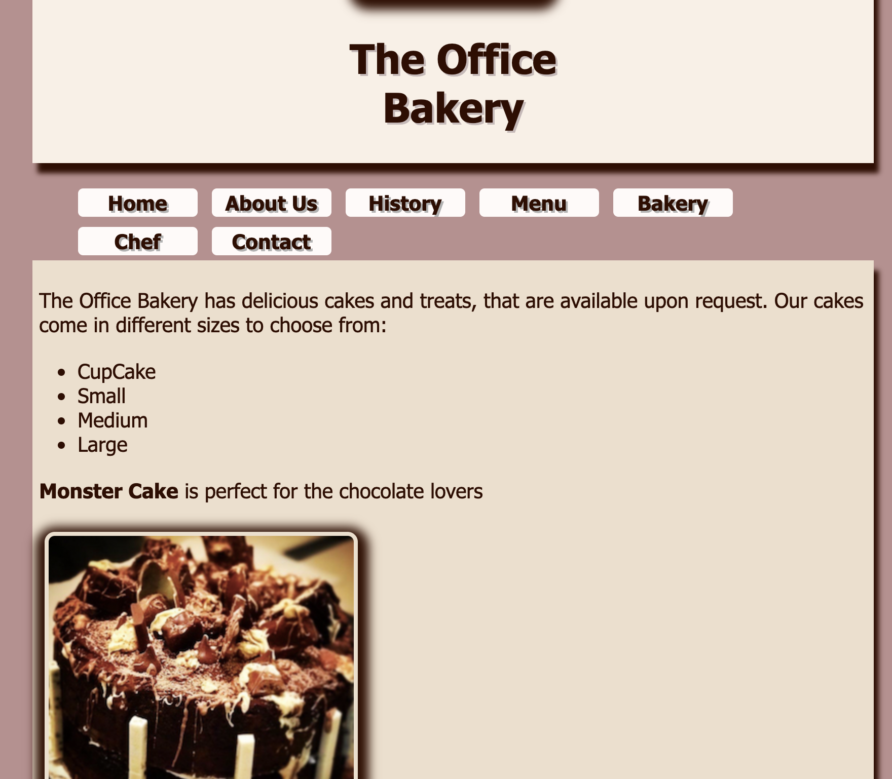

Slide 6
If I Can, You Can
Find what you like
Find 3 job postings
Learn everything in the job is asking for
Don’t deviate from this plan
Make your resume match

Slide 7
Understanding the Business Needs
Job Posting
Strong IT skills including knowledge on hardware, software, networks, and data centers
Thorough work ethic, attention to detail
Ability to identify vulnerabilities and issues
Critical thinking skills, problem solving aptitude
Forensic approach to challenges
Ability to think like a hacker and anticipate hacker moves
Your Resume
Strong IT skills including knowledge on hardware, software, networks, and data centers
Thorough work ethic, attention to detail
Ability to identify vulnerabilities and issues
Critical thinking skills, problem solving aptitude
Forensic approach to challenges
Ability to think like a hacker and anticipate hacker moves

Slide 8
Ask Questions
Make Connections
Stay Trendy

Slide 9
Questions?

